Slide 1

Day10 Questions
Le Cai

Slide 2
512.What are the implicit objects in JSP?
There are the nine type of implicit object, Implicit Objects are also called pre-defined variables. 1) request 2) response 3) application 4) session 5) page 6) pageContext 7) out 8) exception 9) config

Slide 3
513.How will you extend JSP code?
<% >

Slide 4
514.How will you handle runtime exceptions in JSP?
You can catch and handle exceptions in a Java scriptlet within the JSP page itself, using standard Java exception-handling code. Exceptions you do not catch in the JSP page will result in forwarding of the request and uncaught exception to an error page. This is the preferred way to handle JSP errors.

Slide 5
515.How will you prevent multiple submits of a page that come by clickingrefresh button multiple times?
Use unobtrusive javascript to disable the submit event on the form after it has already been submitted. Here is an example using jQuery.
$("body").on("submit", "form", function() {
$(this).submit(function() {
return false;
});
return true;
});

Slide 6
516.How will you implement a thread safe JSP page?
You can make your JSPs thread-safe by having them implement the SingleThreadModel interface. This is done by adding the directive <%@ page isThreadSafe=”false” %> within your JSP page.

Slide 7
517.How will you include a static file in a JSP page?
Static resources should always be included using the JSP include directive. This way, the inclusion is performed just once during the translation phase. The following example shows the syntax: < % @ include file="copyright.html" % >

Slide 8
518.What are the lifecycle methods of a JSP?
jspInit(): This method is called when the JSP page is first loaded into memory by the JSP engine. It is used to initialize any resources or variables required by the JSP page.
jspService(): This method is called for each request to the JSP page. It is responsible for generating the HTML content that will be sent back to the client browser. This method can be overridden by the developer to include their own custom logic.
jspDestroy(): This method is called when the JSP page is removed from memory by the JSP engine. It is used to release any resources or variables used by the JSP page.

Slide 9
519.What are the advantages of using JSP in web architecture?
Easy integration with Java: JSP can be easily integrated with Java code, which allows for dynamic content generation based on user input or data from a database. This makes it easy to build complex web applications that require dynamic content.
Familiar syntax: JSP uses syntax similar to HTML and XML, which makes it easy for web developers to learn and use. It also supports Java code, making it easy to integrate dynamic content with static content.
Enhanced reusability: JSP allows for the separation of presentation logic and business logic, which enhances reusability and makes it easier to maintain and update the code. This also allows developers to work on different parts of the application without interfering with each other's code.
Increased productivity: JSP provides a set of predefined tags that can be used to perform common tasks such as accessing a database, handling user input, and displaying dynamic content. This saves developers time and increases productivity.
Scalability: JSP can be easily scaled to handle high traffic websites by using load balancing techniques, clustering, and caching. This ensures that the website remains responsive even under heavy load.

Slide 10
520.What is the advantage of JSP over Javascript?
Here are some advantages of JSP over JavaScript:
Server-side processing: JSP runs on the server, which means that it can perform more complex operations than JavaScript. For example, JSP can access databases, perform complex calculations, and generate dynamic content based on user input.
Improved performance: Since JSP generates HTML pages on the server, the amount of data transferred to the client browser is reduced. This can improve the performance of the application by reducing page load times and decreasing the amount of network traffic.
Better security: JSP allows developers to validate user input and prevent security vulnerabilities such as cross-site scripting attacks. Since JavaScript runs on the client, it is more vulnerable to attacks.
Better organization: JSP allows developers to separate presentation logic and business logic, which makes it easier to maintain and update the code. JavaScript code can become complex and difficult to manage as the application grows.
Easy integration with Java: JSP is a part of the Java EE (Enterprise Edition) platform and can be easily integrated with other Java technologies such as Servlets and JavaBeans. This allows developers to build complex applications using a wide range of Java technologies.

Slide 11
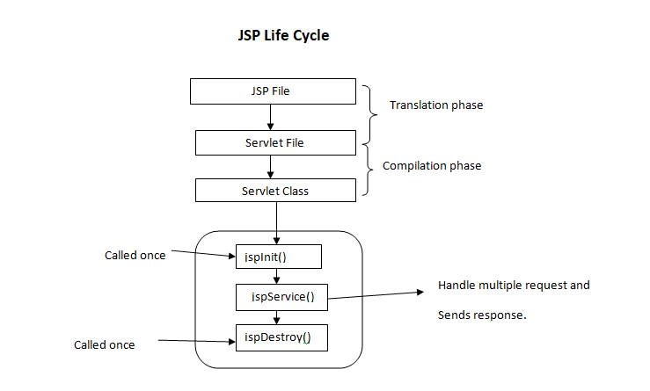
521.What is the Lifecycle of JSP?

Slide 12
522.What is a JSP expression?
Expressions can be used to insert the value of a variable or a method call into a JSP page. For example, consider the following code:
<p>Welcome <%= username %>!</p>

Slide 13
523.What are the different types of directive tags in JSP?
In JSP (JavaServer Pages), there are three types of directive tags that can be used to provide instructions to the JSP container or to define page-level attributes. These are:
Page Directive: This directive is used to define page-level attributes such as scripting language, import statements, and error page settings. It is denoted by the <%@ page %> tag and is placed at the beginning of a JSP page.
Include Directive: This directive is used to include a file or resource in the JSP page. It is denoted by the <%@ include %> tag and is placed anywhere in the JSP page.
Taglib Directive: This directive is used to define and import custom tag libraries into the JSP page. It is denoted by the <%@ taglib %> tag and is placed at the beginning of a JSP page.

Slide 14
524.What is session attribute in JSP?
In JSP (JavaServer Pages), a session attribute is a variable that is associated with a particular user session. When a user visits a web application, the server creates a session object for that user, which can be used to store information about the user's interactions with the application.
A session attribute is simply a key-value pair that is stored in the user's session object. It can be created, read, updated, and deleted using JSP code. Session attributes can be used to store any type of object, including strings, numbers, arrays, and custom objects.
To set a session attribute in JSP, you can use the session.setAttribute() method, as shown in the following example:
<%
String username = "John";
session.setAttribute("username", username);
%>

Slide 15
525.What are the different scopes of a JSP object?
In JSP (JavaServer Pages), there are four different scopes for JSP objects, each of which determines the visibility and lifetime of the object. These scopes are:
Page scope: Objects in the page scope are available only to the JSP page in which they are defined. They are created when the page is loaded and are destroyed when the page is unloaded.
Request scope: Objects in the request scope are available only for the duration of a single HTTP request. They are created when the request is received and are destroyed when the response is sent back to the client.
Session scope: Objects in the session scope are available for the entire duration of a user's session. They are created when the user first visits the application and are destroyed when the session ends.
Application scope: Objects in the application scope are available to all users of the application. They are created when the application is started and are destroyed when the application is stopped.

